Slide 1
Absence Management: Enter an Absence as an Editor/Approver

Slide 2
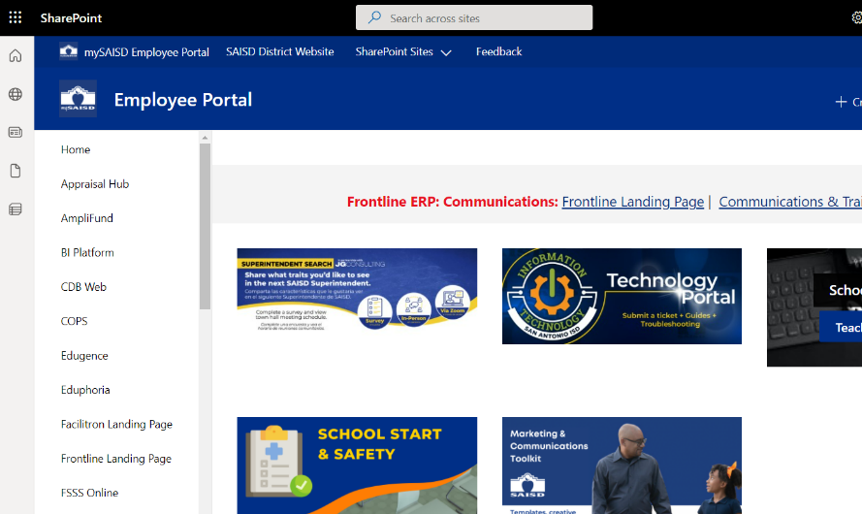
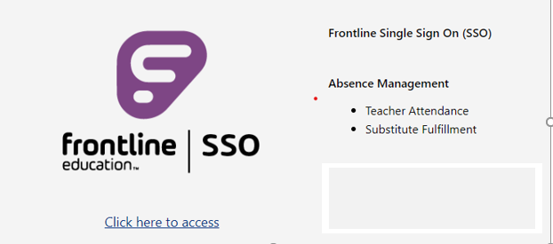
How to Access Absence Management
Access through SAISD Employee Portal:
A.) Click on Frontline Landing Page on the Employee portal page, then click on Click here to access under Frontline SSO on the Frontline Landing Page.

Slide 3
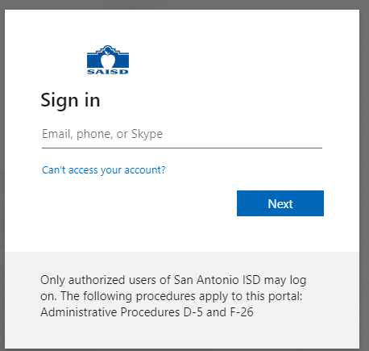
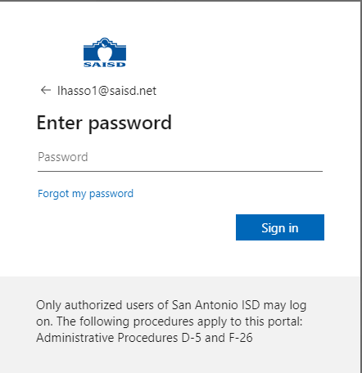
Logging into SSO and Selecting Absence Management
1.) Enter your district email log-in: xxxx1@saisd.net
2.) Enter your district password:
3.) Click on Absence Management from the list of Applications

Slide 4
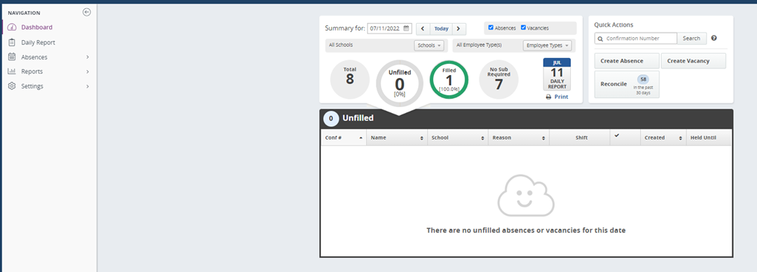
Frontline – Enter an Absence as an Editor/Approver
Click on the “Create Absence” button

Slide 5
Frontline – Enter an Absence as an Editor/Approver
Select the employee's name
Select the date for the absence (if more than one day we recommend you split the assignment day to day.)
Select the absence reason
Select the absence Type – Full day or Half day
Select add days
REVIEW - “Substitute Required”? Yes or No
Review & Confirm
2
3
4
5
6
7
Note: Employee or secretary (or designee) must cancel absence in Absence Management
Employee has the ability to cancel the absence prior to the date or within one hour on the date of the scheduled absence

